Slide 1
Sensory Receptors
Somatic senses
Cutaneous receptors (6 kinds)
Thermoreceptors
Tendon receptors
Muscle stretch receptors
Special Senses
Vision
Taste
Olfaction

Slide 2
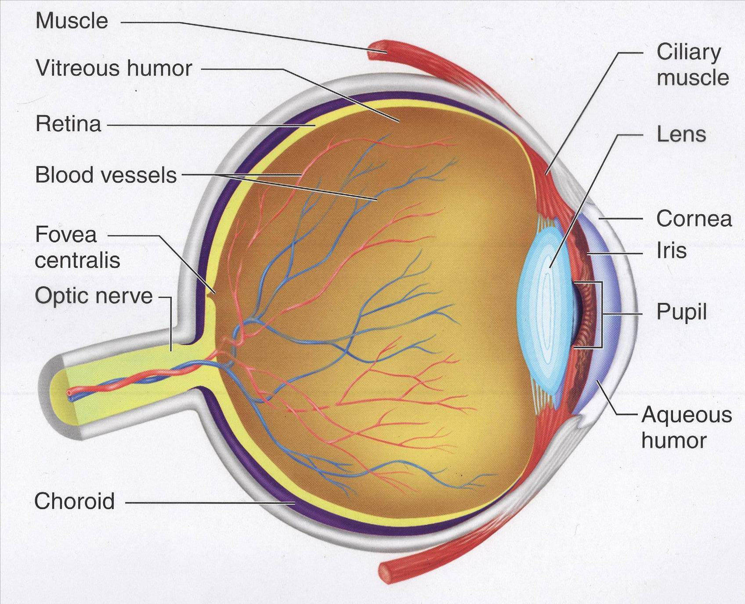
Photoreception

Slide 3
Macroanatomy of the Eye
Manage light levels | Focus light | Maintenance | Phototransduction
Iris (pupil) Choroid | Cornea Suspensory ligaments Ciliary muscle Lens | Sclera Blood vessels Aqueous humor Vitreous humor | Retina Optic nerve

Slide 4
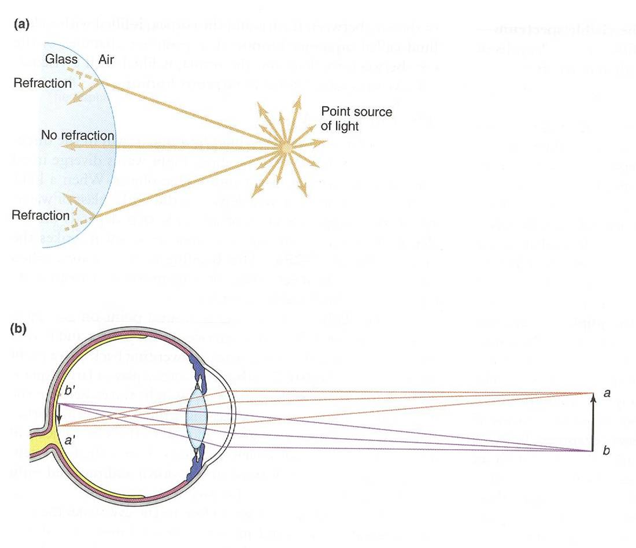
Refraction

Slide 5
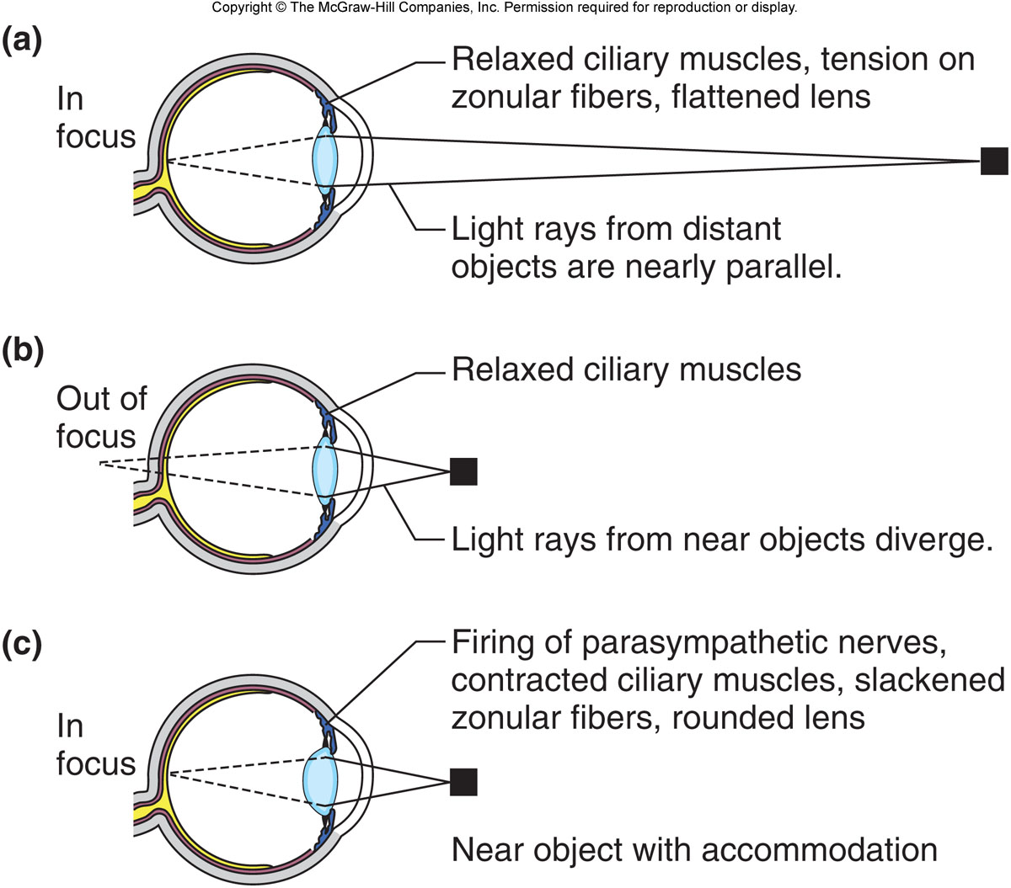
Accommodation = ability to focus objects different distances from the eye

Slide 6
Phototransduction

Slide 7
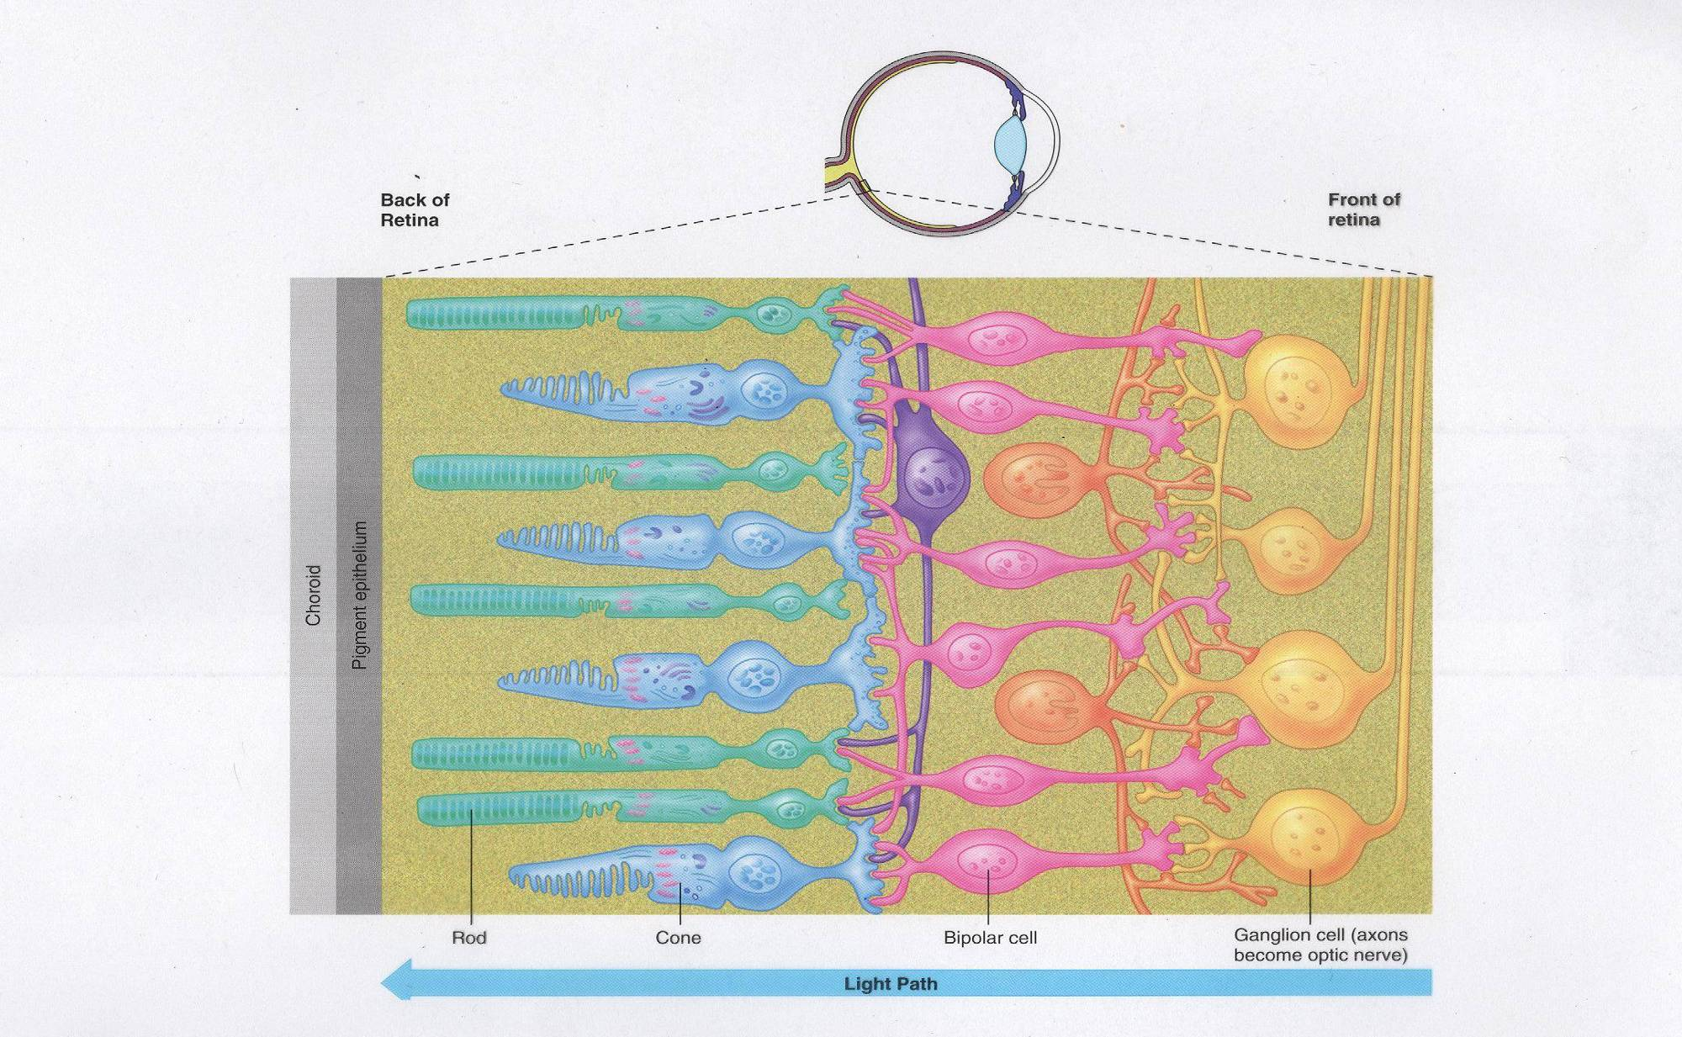
Microanatomy of the Retina

Slide 8
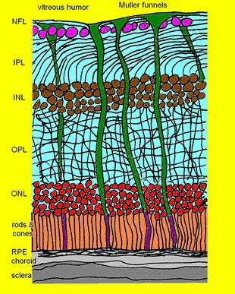
Overlayer of photoreceptors serves a function!

Slide 9
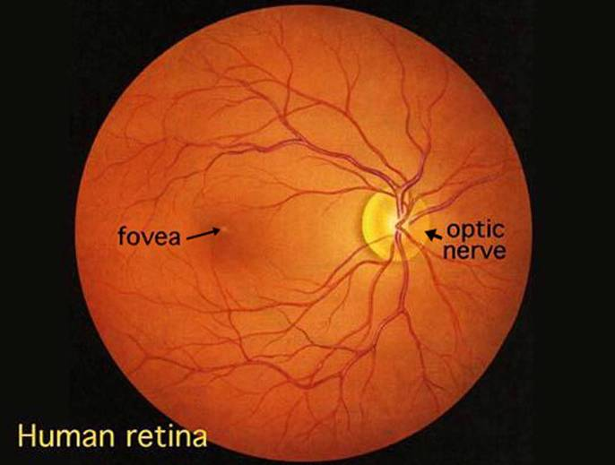

Slide 10
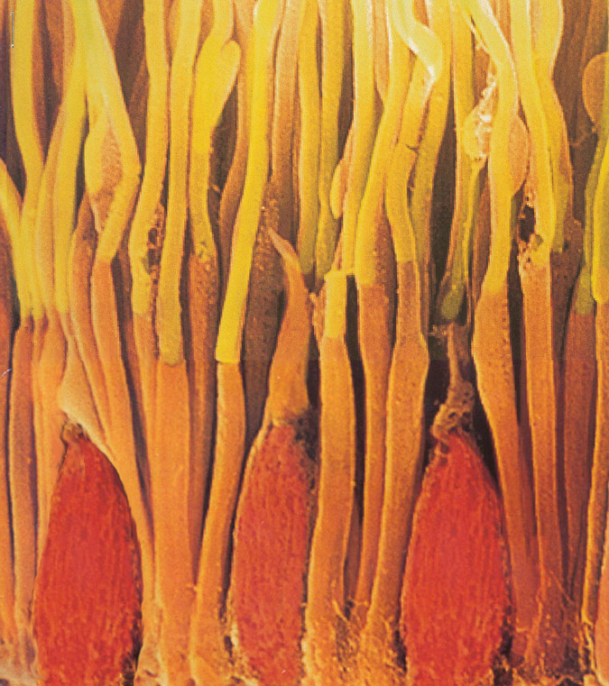
A sea of photoreceptors

Slide 11
Photoreceptors
Rods = changes in light levels
Cones = differentiate colors; three types in humans
Rods and cones are unevenly distributed.
Cones confer greater visual acuity than rods, but rod cells are more sensitive to light.
Why?

Slide 12
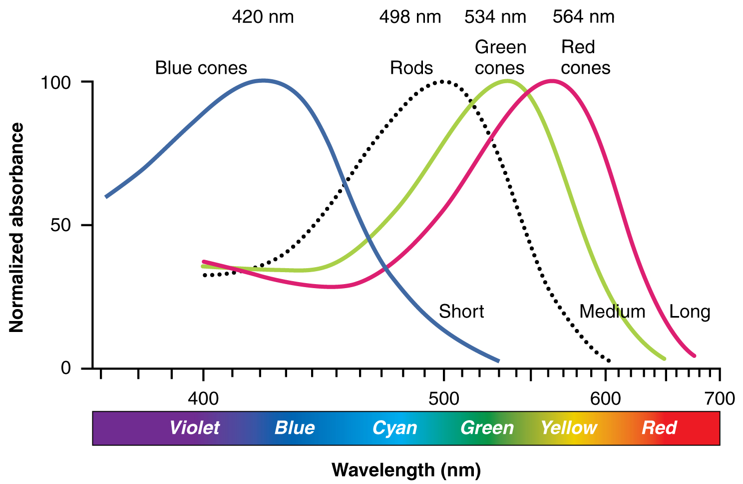

Slide 13
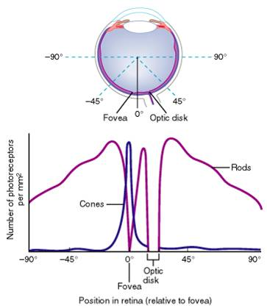

Slide 14
Subconscious Responses to Light
Not regulated by rods or cones
Melanopsin: pigment found in light-sensitive ganglion cells

Slide 15
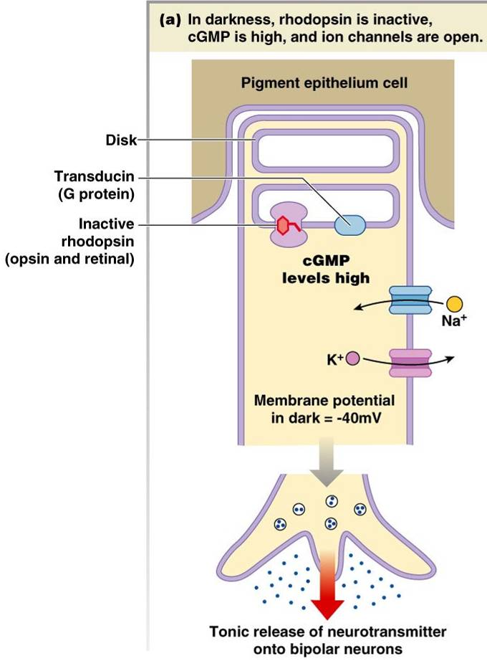
Phototransduction in Rods – Sequence of Events
Conversion of light energy into electrical signals
In the dark, rhodopsin is intact and
Na⁺ and K⁺ channels are open.
resting membrane potential = -40 mV
cGMP levels are high
In this state, there is tonic release of neurotransmitter.
Page 366

Slide 16
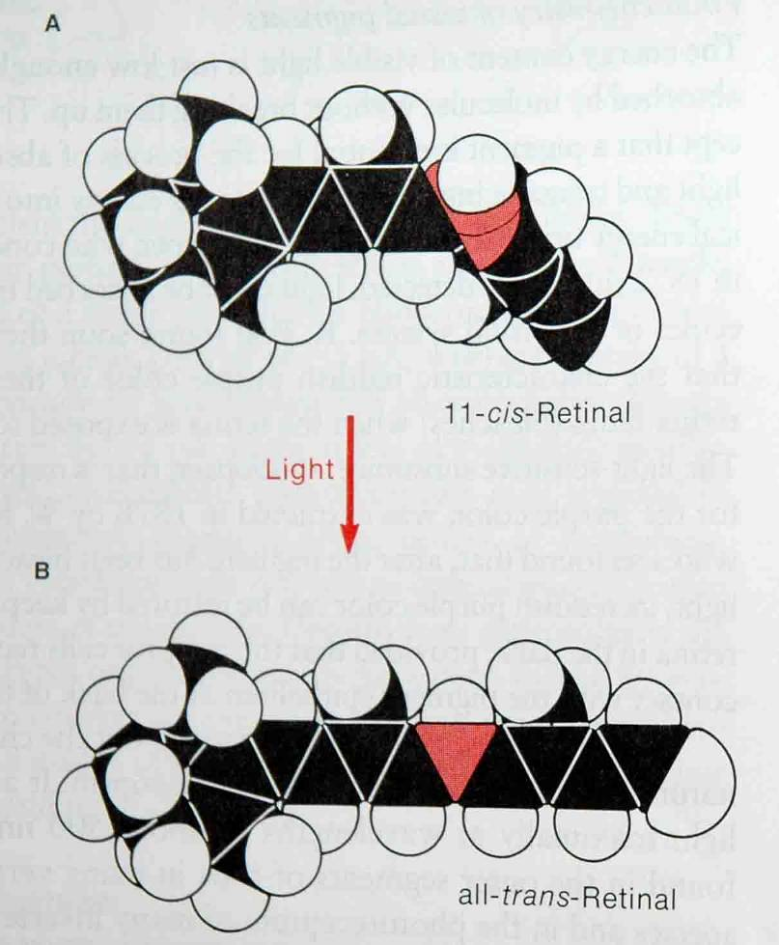
Retinal has two conformations
Cis form binds to opsin
Trans form dissociates from opsin

Slide 17
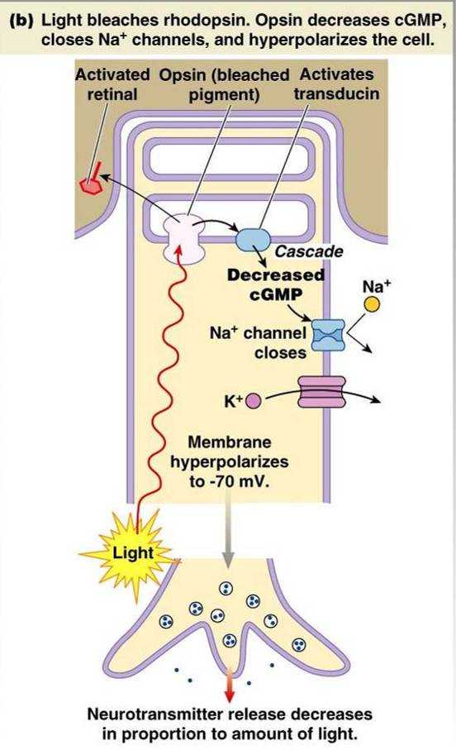
Phototransduction in Rods – Sequence of Events
Conversion of light energy into electrical signals
2a. When light strikes rhodopsin, retinal
changes conformation and binds to the
pigemented epithelium.
Rhodopsin→Opsin (molecule is bleached), which activates a 2nd messenger (transducin)
cGMP is decreased, causing Na⁺
channels to close.
Opsin & Rhodopsin conform to Law of Mass Action
(Adaption occurs over time)

Slide 18
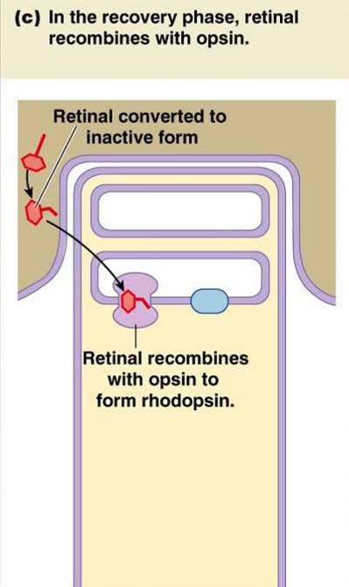
Phototransduction in Rods – Sequence of Events
Conversion of light energy into electrical signals
2b. During recovery (light stimulus removed),
retinal is converted back to its inactive
form and it binds to opsin.
Na⁺ channels reopen, neurotransmitter
secretion increases.

Slide 19
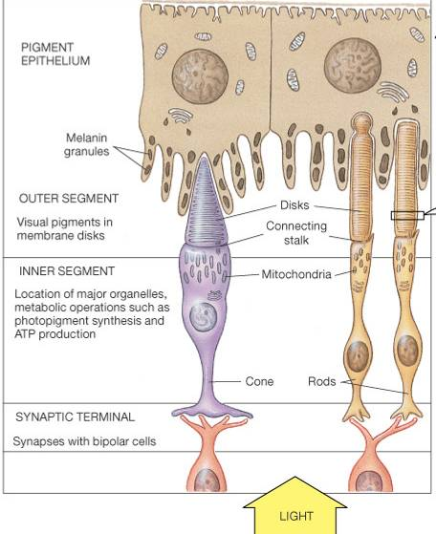
Phototransduction in Rods – Sequence of Events
3. Hyperpolarizing membrane
potential causes closing of
Ca⁺⁺ channels in inner segment
4. Less Ca²⁺ enters cell, neurotransmitter release declines (glutamate)

Slide 20
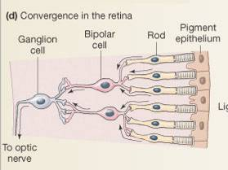
*Bipolar cells generate graded potentials only; cannot generate action potentials; these graded potentials can be excitatory or inhibitory (even though neurotransmitter released by photoreceptors is the same – glutamate)
As light levels increase:
ON pathways: rods ↓ glutamate secretion → bipolar cells ↓ breakdown of cGMP (so more cGMP present), Na⁺ channels open, cell depolarizes, so more NT to ganglion cells and more APs
OFF pathways: rods ↓ glutamate → closes bipolar cell cation channels, cell hyperpolarizes, so less NT to ganglion cells and fewer APs
Ganglion cells exit via the optic nerve and transmit action
potentials to the brain.
Each ganglion cell receives information from
many photoreceptors. Each ganglion’s
receptors are grouped into a ‘receptor field.’
Receptive fields are composed of either all
‘ON’ or all ‘OFF’ bipolar cells.
Refer to p. 214

Slide 21
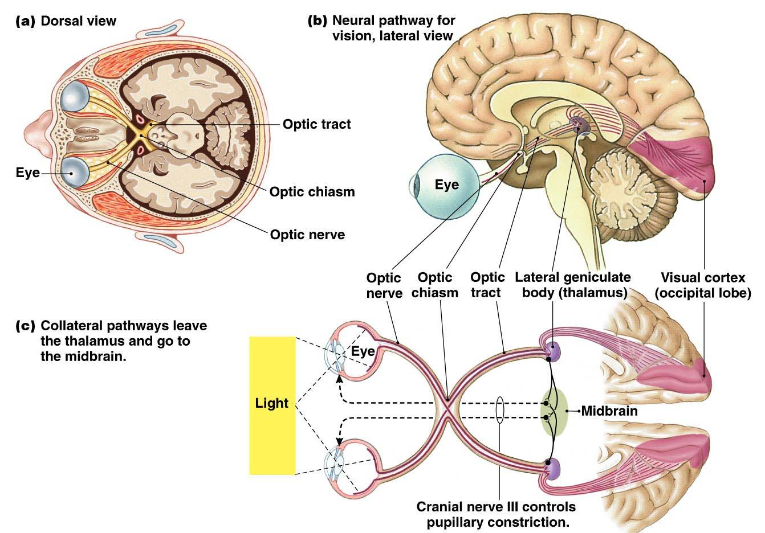

Slide 22
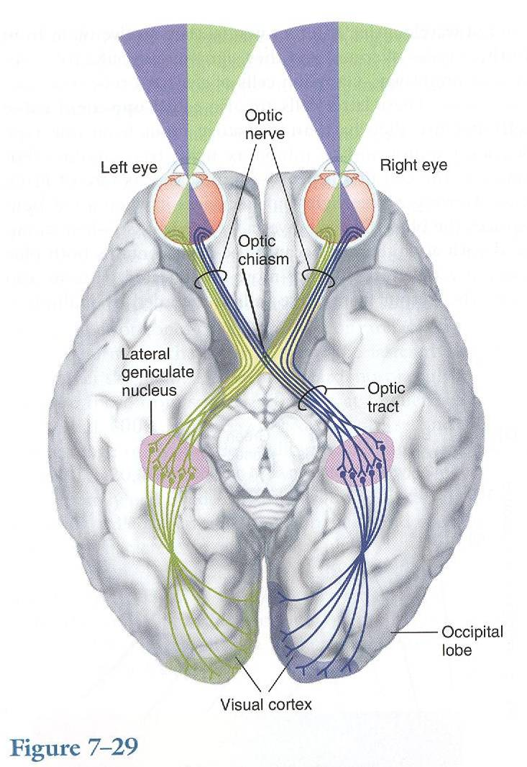

Slide 23
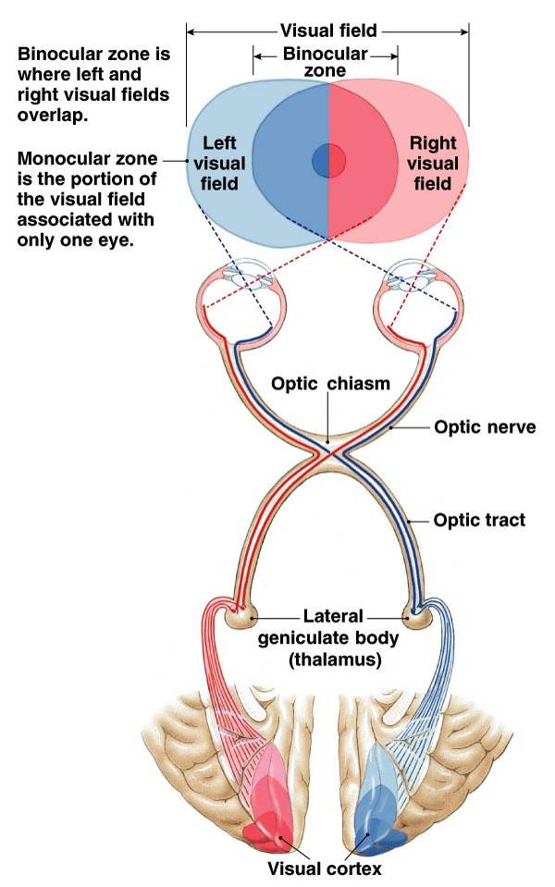
Binocular vision → 3D
Monocular vision → 2D
Topographical organization of
LGB (thalamus) is maintained in
visual cortex

